Slide 1
ConScript
Specifying and Enforcing Fine-Grained Security Policies
for JavaScript in the Browser
Leo Meyerovich
UC Berkeley
Benjamin Livshits
Microsoft Research

Slide 2
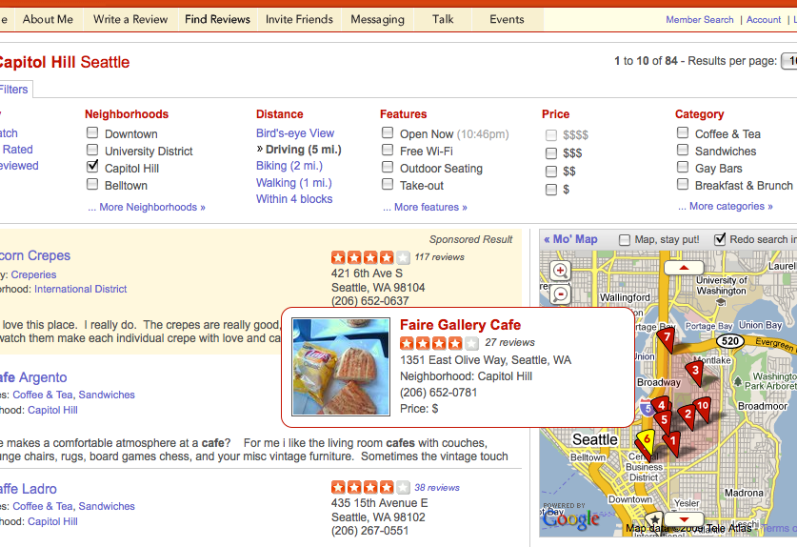


Web Programmability Platform
openid.net
yelp.com
adsense.com
Google maps
Notes:
Add site names

Slide 3
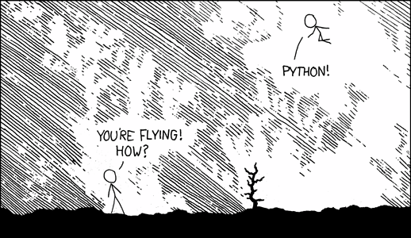
Rich Internet Applications are Dynamic
Yelp.com:
main.js
… jQuery.js
… adSense.js
… GoogleMaps.js
… OpenID_API.js
flexible runtime composition
… but little control.
Notes:
Yelp (host) is being presented to end user
Relies upon scripts from third-parties (runtime)
… at expense of loss of control

Slide 4

Towards Safe Programmability for the Web
Can’t trust other people’s code
Mash-ups

Slide 5
Goals and Contributions
control loading and use of scripts
express many policies safely
17 hand-written policies
browser support
built into IE 8 JavaScript interpreter
protect benign users
implemented 2 policy generators
proposed type system to catch common attacks
runtime and space overheads under 1% (vs. 30-550%)
correct policies are hard to write
ConScript approach: aspects for security
by giving control to hosting site
smaller trusted computing base (TCB)
Notes:
Animation to unfoldj [toplevel]

Slide 6
approach protect benign users by giving control to the hosting site : aspects for security

Slide 7
ConScript
Approach
protect benign Web users
give control to the hosting site
How
Browser-supported aspects for security

Slide 8
Contributions of ConScript
A case for aspects in browser
Evaluation
Tested on real apps: Google Maps, Live Desktop, etc.
protect benign users by giving control to hosting site
implemented 2 policy generators
runtime and space overheads under 1% (vs. 30-550%)
ConScript approach: aspects for security
smaller trusted computing base (TCB)
Correctness checking
Policies are easy to get wrong
Expressiveness
Type system to ensure policy correctness
17 hand-written policies
Comprehensive catalog of policies from literature and practice
built into IE 8 JavaScript interpreter

Slide 9
Policies
manifest of script URLs
HTTP-only cookies
no hidden frames
script whitelist
<noscript>
no URL redirection
no pop-ups
enforce public vs. private
no foreign links
resource blacklists
limit eval
Notes:
Highlight policies as discussed (new circle)
[remove manual vs auto policies]

Slide 10
ConScript aspects
implementing aspects in IE8
checking ConScript policies
generating ConScript policies
performance
Notes:
1. ben’s version that highlights “ConScript”

Slide 11
eval is evil
function () {
throw ‘Disallowed’
};
window.eval =
stack
heap
document
function
eval
window
x
heap object
y
eval
bar
z
foo
…
div
eval

Slide 12
No postMessage: A Simple Policy?
Wrapping: [[Caja, DoCoMo, AOJS, lightweightjs, Web Sandbox, …]]
window.postMessage = function () {};
frame1.postMessage(“msg”, “evil.com”)
Aspects: [[AspectJ]]
void around(String msg, String uri) :
call DOM.postMessage(String m, String u) { /* do nothing instead of call */ }
… no classes in JavaScript / DOM …

Slide 13
Specifying Calls using References
[Object window]
postMessage
function () { [native code]
}
function () {
throw ‘exn’;
}
[Object frame]
postMessage
around(window.postMessage, function () { throw ‘exn’; });

Slide 14
ConScript Interface
Functions
DOM: aroundExt(postMessage, function (pm2, m, uri) { … });
JS: aroundNat(eval, function (eval, str) { … });
User-defined: aroundFnc(foo, function (foo2, arg1) { … });
2. Script introduction
<script>: aroundScr(function (src) { return src + ‘;’ + pol;});
inline: aroundInl(function (src) { return src + ‘;’ + pol;});
Notes:
2 slides seq:
1. example of function and example of script
2. actual interface

Slide 15
ConScript aspects
implementing aspects in IE8
checking ConScript policies
generating ConScript policies
performance
Notes:
1. ben’s version that highlights “ConScript”

Slide 16
Problem: Implementation?
Source Rewriting [[aojs, docomo, caja, sandbox, fbjs]]
☹ 50%-450% more to transfer, 30-70% slowdown
limited: native (DOM) functions, dynamic code?
big assumptions: adds parser to TCB, …
function f () { … }
function f () {<before> … <after>}
Notes:
1. Before our approach, talk about state-of-the-art
2. Reverse order of limitaitons

Slide 17
Mediating DOM Functions
window.postMessage
IE8 libraries (HTML, Networking, …)
JavaScript interpreter
postMessage
advice dispatch
0xff34e5
0xff34e5
arguments: “hello”, “evil.com”
call | advice
0xff34e5
off
aroundExt(window.postMessage,
[not found]
off
);
frame2.postMessage

Slide 18
Resuming Calls
function (eval, str) { if (ok(str)) {
bless();
return eval(str);
} else throw ‘exn’; }
3. function (eval, str) { if (ok(str)) return eval(str);
else { curse(); throw ‘exn’; }}
function foo () { }
function foo () { }
advice on
advice off
function advice1 (foo2) {
if (ok()) {
foo2();
} else throw ‘exn’; }
function advice2 (foo2) {
if (ok()) {
bless();
foo2();
} else throw ‘exn’; }
bless() temporarily disables advice for next call

Slide 19
Optimizing the Critical Path
function foo () { }
function foo () { }
advice off
advice on
advice on
function advice3 (foo2) {
if (ok()) foo2();
else {
curse();
throw ‘exn’; } }
function advice2 (foo2) {
if (ok()) {
bless();
foo2();
} else throw ‘exn’; }
calling advice turns advice off for next call
curse() enables advice for next call

Slide 20
ConScript aspects
implementing aspects in IE8
checking ConScript policies
generating ConScript policies
performance
Notes:
1. ben’s version that highlights “ConScript”

Slide 21
Basic Usage
script whitelist
no eval
Yelp.com: main.js, index.html
… jQuery.js
… adSense.js
… GoogleMaps.js
… OpenID_API.js
SURGEON GENERAL’S WARNING
Policies are written in a small JavaScript subset.
Applications only lose a few dangerous features.
no innerHTML
no hidden frames
no inline scripts
only HTTP cookies
<script src=“main.js” policy=“noEval()”/>

Slide 22
Policy Integrity
Objects defined with policy constructors do not flow out
Old Policy
around(postMessage, function (m, url) {
w = {“msn.com”: true};
…

Slide 23
Policy Integrity
Objects defined with policy constructors do not flow out
Old Policy
around(postMessage, function (m, url) {
w = {“msn.com”: true};
…
policy object: must protect
unknown: do not pass privileged objects!

Slide 24
Policy Integrity
Objects defined with policy constructors do not flow out
Old Policy
around(postMessage, function (m, url) {
w = {“msn.com”: true};
…
User Exploit
postMessage(“”, “msn.com”);
w[“evil.com”] = 1;
postMessage(“”, “evil.com”);

Slide 25
Policy Integrity
Objects defined with policy constructors do not flow out
New Policy
around(postMessage, function (m, url) {
window.w = {“msn.com”: true};
…
User Exploit
postMessage(“”, “msn.com”);
w[“evil.com”] = 1;
postMessage(“”, “evil.com”);
var w

Slide 26
Policy Integrity
Objects defined with policy constructors do not flow out
New Policy
around(postMessage, function (m, url) {
window.w = {“msn.com”: true};
…
policy object: must protect
unknown: do not pass privileged objects!
var w

Slide 27
Maintaining Integrity
Policy objects do not leak out of policies
Access path integrity of calls (no prototype hijacking)
ML-style type inference
☹ basic
☺ program unmodified
😐 only manually tested on policies
JavaScript interpreter support
call(ctx, fnc, arg1, …), hasOwnProperty(obj, “fld”)
caller

Slide 28
Transparency
If running with policies throws no errors
… for same input, running without should be safe
empty advice should not be functionally detectable
Difficult with wrapping or rewriting
Function.prototype.apply, exn.stacktrace, myFunction.callee, arguments.caller, myFunction.toString, Function.prototype.call
correctness vs. compatibility vs. performance …
Simpler at interpreter level
rest up to developer
no proof

Slide 29
ConScript aspects
implementing aspects in IE8
checking ConScript policies
generating ConScript policies
performance
Notes:
1. ben’s version that highlights “ConScript”

Slide 30
Automatically Generating Policies
Intrusion detection
can we infer and disable unneeded DOM functions?
C# access modifiers
can we enforce access modifiers like private?
ASP policies
can we guarantee no scripts get run in <% echo %>?

Slide 31
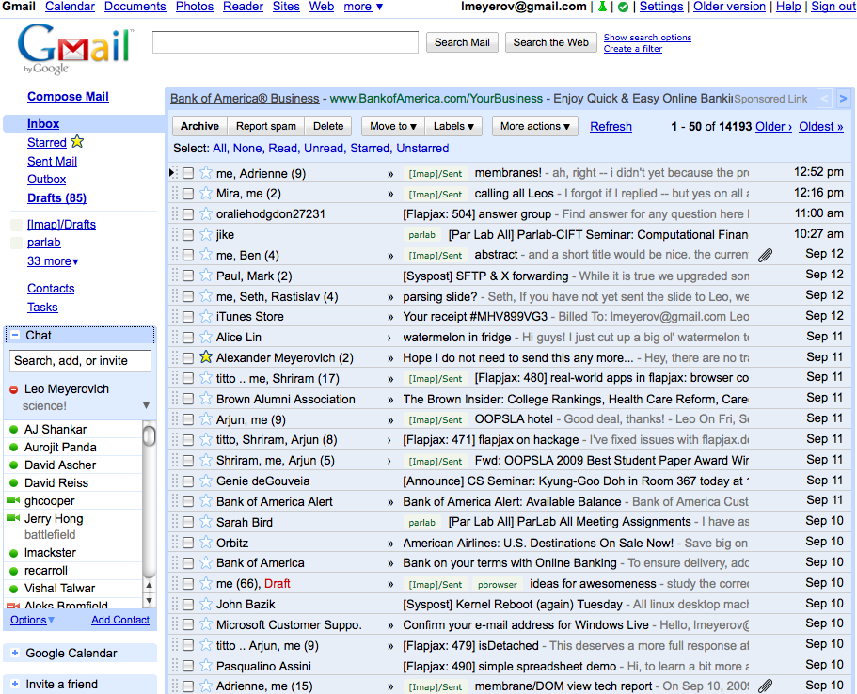

Intrusion Detection 1: Learn Blacklist
log
eval
new Function(“string”)
postMessage
XDomainRequest
xmlHttpRequest
…
audit

Slide 32
Intrusion Detection 2: Enforce Blacklist

Slide 33
Enforcing C# Access Modifiers
class File {
public File () { … }
private open () { … }
…
Script#
compiler
function File () { … }
File.construct = …
File.open = …
…
C#
JavaScript
policy
generator
around(File, pubEntryPoint);
around(File.construct, pubEntryPoint);
around(File.open, privCall);
ConScript

Slide 34
ConScript aspects
implementing aspects in IE8
checking ConScript policies
generating ConScript policies
performance
Notes:
1. ben’s version that highlights “ConScript”

Slide 35
Performance
Microbenchmarks: 1.2x (vs. 3.4x)
Initialization time: 0-1%
Runtime: 0-7% (vs. 30+%)
File size blowup: < 1% (vs. 50+%)

Slide 36
Microbenchmark: Mediation Overhead
var raw = obj.f;
obj.f = function () { raw();}
3.42x
function advice2 (foo2) {
bless();
foo2();
}
1.44x
function advice3 (foo2) { foo2();
}
1.24x

Slide 37
File Size Increase (IDS)

Slide 38
Intrusion Detection System
Runtime Overhead
Access
Modifier
Enforcement

Slide 39
Goals and Contributions
control loading and use of scripts
express many policies safely
16 hand-written policies
browser support
built into IE 8 JavaScript interpreter
protect benign users
implemented 2 policy generators
proposed type system to catch common attacks
runtime and space overheads under 1% (vs. 30-550%)
correct policies are hard to write
ConScript approach: aspects for security
by giving control to hosting site
smaller trusted computing base (TCB)
Notes:
Animation to unfoldj [toplevel]

Slide 40
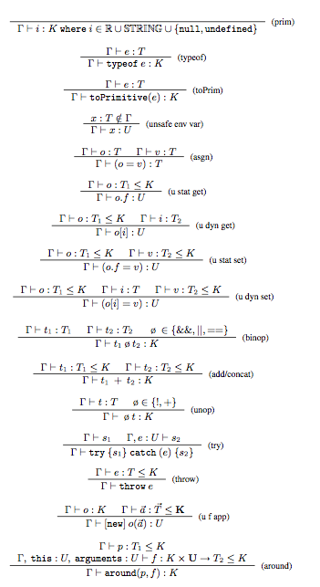
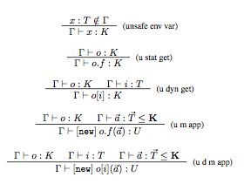

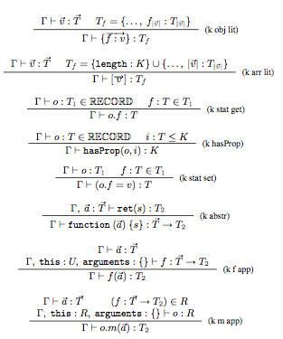
Questions?
manifest of URLs
limit eval
no foreign links
no hidden frames
script whitelist
<noscript>
no URL redirection
HTTP-only cookies
no pop-ups
enforce public vs. private
resource blacklists

Slide 41
END.

Slide 42
Conclusion
Security mechanisms should be deep & in browser
around
aroundScr, aroundInl
optimized around
Expressing policies is hard
16 handwritten policies [[TODO average size]]
designed static analysis
blacklist generator prototype
private function policy generator
Policy enforcement must be cheap
file size increase: < 1% (vs. 50-104%)
initialization: could not detect!
runtime: could not detect!

Slide 43
Integrity 2/2: No Hijacked Calls
objects defined with policy constructors do not flow out
Old Policy
around(window.eval, function (oldEval, str) {
var hash = str.reverse(); …
User Exploit
String.prototype.reverse =
function () { return “forged”; };
eval(“alert()”);

Slide 44
Integrity 2/2: No Hijacked Calls
objects defined with policy constructors do not flow out
Old Policy
around(window.eval, function (oldEval, str) {
var hash = str.reverse(); …
policy object: privileged, callable object
environment object: untrusted, unhijacked (directly callable)
unknown: untrusted, uncallable object

Slide 45
Integrity 2/2: No Hijacked Calls
objects defined with policy constructors do not flow out
New Policy
around(window.eval, function (oldEval, str) {
var hash = str.reverse(); …
User Exploit
String.prototype.reverse =
function () { return “forged”; };
eval(“alert()”);
var r = “”.reverse;
call(str, r)

Slide 46
Integrity 2/2: No Hijacked Calls
objects defined with policy constructors do not flow out
New Policy
around(window.eval, function (oldEval, str) {
var hash = str.reverse(); …
policy object: privileged, callable object
environment object: untrusted, unhijacked (directly callable)
unknown: untrusted, uncallable object
var r = “”.reverse;
call(str, r)

